Slide 1
Harmony in the Family
Understanding Relationship
– Trust

Slide 2
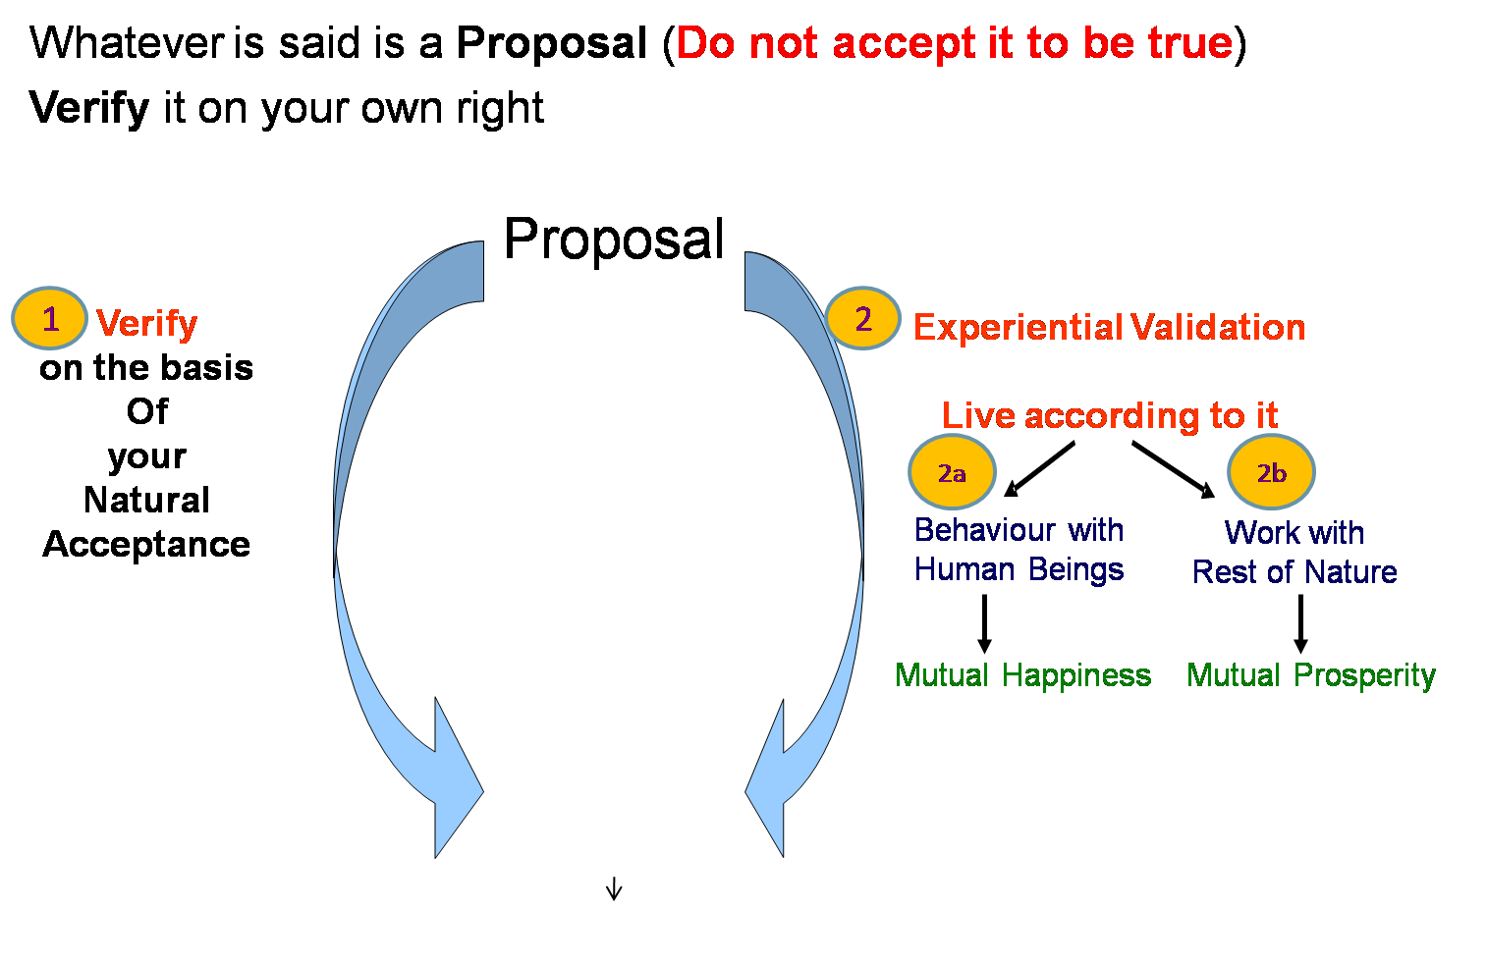
Self-exploration, Self-investigation, Self-study
1. Content of Self Exploration:
  a. Desire (pkguk) - Aim, Purpose
  b. Program (djuk) – Process of achieving the desire, action
Happiness = To be in Harmony
2. Process of Self Exploration
Self-verification
– Happiness, Prosperity → Continuity
To understand Harmony & to live in harmony at all 4 levels:
  Harmony in the Human Being
  Harmony in the Family
  Harmony in the Society
  Harmony in Nature/Existence

Slide 3
Harmony in the Family
Relationship is – between one self (I₁) and other self (I₂)
There are feelings in relationship – in one self (I₁) for other self (I₂)
These feelings can be recognized – they are definite (9 Feelings)
Their fulfilment, evaluation leads to mutual happiness
Feelings in relationship:
Are these feelings Naturally Acceptable to You?
When you live with these feelings, does it lead to your happiness?
When you express these feelings to the other, does it lead to the happiness of the other?
1- Trust fo”okl FOUNDATION VALUE
2- Respect lEeku
3- Affection Lusg
4- Care eerk
5- Guidance okRlY;
6- Reverence J)k
7- Glory xkSjo
8- Gratitude —rKrk
9- Love izse COMPLETE VALUE

Slide 4
Harmony in the Family
Relationship is – between the self (I) and the other self (I)
There are feelings, or expectation of feelings, in relationship – of one self (I) for the other self (I)
These feelings can be recognized – they are definite (9 Feelings)
Their fulfillment and evaluation leads to mutual happiness
Evaluation:
Are these feelings in me?
Are these feelings reaching to the other?
I evaluate this from time to time
Will you ensure these feelings in yourself or expect them from the other? Ensuring these feelings in yourself is swatantrata; expecting them from the other is dependence (partantrata).

Slide 5
Trust (fo”okl)
Trust = to be assured (vk”oLr gksuk)
= to have the clarity that the other wants to make me
happy & prosperous
= nwljk esjs lq[k] le`f) ds vFkZ esa gS] ,Slk Li’V gksuk

Slide 6
Trust (fo”okl)
Trust = to be assured (vk”oLr gksuk)
= to have the clarity that the other wants to make me
happy & prosperous
= nwljk esjs lq[k] le`f) ds vFkZ esa gS] ,Slk Li’V gksuk
In every small interaction, we evaluate “is the other standing on my side, or not”

Slide 7
In any situation, I evaluate
Is the other standing with me (TRUST)? or away from me (NOT TRUST)?
is the other going to help me? or is he just judging/condemning me?
Is the other going to be there when I try? or is he just giving "ideas" for me to try on my own?

Slide 8
Evaluating Trust – Between 2 Individuals
Verify on the basis of your natural acceptance
1a. I want to make myself happy
2a. I want to make the other happy
3a. The other wants to make herself/himself happy
4a. The other wants to make me happy
Verify on the basis of your competence
1b. I am able to make myself always happy
2b. I am able to make the other always happy
3b. The other is able to make herself/himself always happy
4b. The other is able to make me always happy
√
?
√
?
√
?
?
??
Intention – Natural Acceptance
What is Naturally Acceptable to Me
Competence
What I am (∑ D, T, E)

Slide 9
About the Other About Myself
The other broke a glass
The other makes mistakes intentionally
The other intended to break the glass – The other is a bad person
The glass broke by accident
I make mistakes by accident
Even if I make the same mistake 100 times, I never doubt my intention – I always feel I am a good person
I evaluate my self on my intention (2a) ... I conclude “I am good”
I evaluate the other on his competence (4b) ... I conclude “the other is bad”
I conclude about the intention of the other on the basis of his competence ... I doubt his intention
Irritation, anger, condemning the other are indications of doubt on intention
Doubt on intention is a major reason for problems in relationships

Slide 10
Trust
Trust on Intention = To be Assured
= to have the clarity that the other wants to make me happy &
prosperous
= nwljk esjs lq[k] le`f) ds vFkZ esa gS] ,slk Li’V gksuk
When there is Trust on Intention, you feel related to the other
Absence of Trust on Intention
= lack of assurance that the other intends my happiness & prosperity
Lack of Trust on Intention leads to Doubt, Fear, Opposition…
Verify on the basis of your natural acceptance
1a. I want to make myself happy
2a. I want to make the other happy
3a. The other wants to make herself/himself happy
4a. The other wants to make me happy
Verify on the basis of your competence
1b. I am able to make myself always happy
2b. I am able to make the others always happy
3b. The other is able to make herself/himself always happy
4b. The other is able to make me always happy
√
?
√
?
√
?
?
√
??
Natural Acceptance, ie Intention
What we really want to be
Competence
What we are

Slide 11
Opposition Trust
If I do not have trust on intention,
I feel opposed to the other
I evaluate myself on the basis of my intention and others on the basis of their competence (seldom evaluating at my competence and others’ intention)
In case the other is lacking in competence & I assume it to be his intention, the feeling of opposition reflects as reaction, irritation, anger on the other
(Small acts of mistrust stay in the thoughts, multiply & grow as doubt, fear, break-up.. Opposition ultimately leads to fighting, struggle and even war)
If I have trust on intention, I feel related to the other – unconditional, continuous
I make a program with the other based on right evaluation of the intention & competence of both
In case the other is lacking in competence
I live with responsibility with the other, knowing that he may make more mistakes than me, do reaction, have uncertain conduct
I facilitate understanding in the other once the other is assured in relationship (and not before that)

Slide 12
Trust (Right Understanding) Misconceptions about Trust
Trust = fn (
1- my understanding about relationship & trust,
2- my awareness about my Natural Acceptance)
Program = fn (1- right evaluation of my competence & other’s competence)
I have a proactive role to play in the program & development of mutual competence
Trust is definite and unchanging
For more on right evaluation, see Respect
Trust = fn (
1- the competence of the other,
2- my assumption about myself, about the other)
Program = fn (1- my expectation from the other)
I have no role to play in the program (I am the consumer). I am good, so I do not have to work on my competence. The other is bad – he can never develop (I condemn him)
Trust keeps changing

Slide 13
How many persons do you have trust on intention
– continuous, unconditional (never having a feeling of opposition, getting irritated or angry)
– in case the other is lacking in competence, you have a feeling of responsibility to improve his competence?
vkidk fdrus yksxksaa ds pkguk ds izfr fo'okl gS!
& ftuds izfr [kht] fp<+ ugha vkrh
dzks/k ^^ ^^
fojks/k dk Hkko ^ ^^
& ftudh ;ksKrk ds vÒko dks iwjk djus esa lg;ksx djrs gSa
Is increase in this number progress or decrease in this number progress?
budh l[;k dk c<+uk fodkl gS ;k ?kVuk !

Slide 14
Check within yourself
How many persons do you have trust on intention (natural acceptance)
– unconditional, continuous?
If you have unconditional, continuous trust on intention (natural acceptance) of the other and if the other is lacking competence, what will you do:
  Try to improve his competence
  Get irritated
  Get angry
  Have a feeling of opposition
This is fundamental. Trust on intention is the foundation of relationship
You can get an idea of the state of your understanding about relationship from this… and make a program accordingly
If Trust on Intention
If Doubt on Intention

Slide 15
Trust on Intention is Trust on Competence would be
To be assured that the other wants to make me happy & prosperous
In making the program of interaction, one would evaluate one’s own competence* as well as the competence* of the other.
If the evaluation of the competence is right, the program is likely to succeed.
If the program is unsuccessful, one would re-evaluate the competence of both and try to improve it, rather than blaming, getting irritated etc.
To be assured that the other wants to make me happy and prosperous
AND
That the other has the competence* to make me happy and prosperous
* Competence = Understanding, Feeling & Skill
If one has such an assumption or expectation, he may be disappointed, as the other may or may not have the necessary competence

Slide 16
Sum Up
Trust is to have the clarity that the other wants to make me happy & prosperous
If I have trust on intention, I feel related to the other – I recognise see my complimentarity with the other. I make a program with the other based on right evaluation of our mutual competence
In case the other is lacking in competence:
  I live with responsibility with the other, knowing that he may make more mistakes than me, do reaction, have uncertain conduct
  I facilitate understanding in the other once the other is assured in relationship (and not before that)
If I lack competence, I become ready to take help from the other to improve my competence
If I do not have trust on intention
  I evaluate myself on the basis of my intention and others on the basis of their competence (seldom evaluating my competence and others’ intention)
  I have a feeling of opposition with the other which shows up as irritation or anger (and it further leads to fighting, struggle and war)

